Slide 1
Drop-Out Prevention:
Increasing Graduation Rates for At-Risk, Homeless, Neglected and Delinquent Youth
FY12 Data Collections Conference
Athens, Georgia
August 18, 2011
Eric McGhee, Grant Programs Manager
Outreach Programs Division
School Improvement

Slide 2
Content
Overview of Title I, Part D
  Subpart 1
  Subpart 2
Overview of Title X, Part C
Georgia Homeless Data
Graduation Rate Information
Prevention & Intervention Strategies

Slide 3
Overview of Title I, Part D
Neglected, Delinquent and At-Risk Youth Education Program

Slide 4
Overview of Title I, Part D
Neglected and Delinquent Children defined:
Neglected = Children and youth who are in need of care due to abandonment, neglect, or death of their parents or guardians.
Delinquent = Children who have been adjudicated to be delinquent or in need of supervision.

Slide 5
Overview of Title I, Part D
Grantees and Population
Title I, Part A
  Provides financial assistance to LEAs and schools with high numbers or high percentages of poor children to help ensure that all children meet challenging state academic standards.
  US ED determines the LEA Title I, Part A neglected set-aside amount based on the neglected child count derived from the N&D Annual Survey.
Title I, Part D
  Subpart 1 - Provides financial assistance to educational programs for youth in state-operated facilities or community day programs.
  Subpart 2 - Provides financial assistance to support eligible LEA programs involving collaboration with locally operated correctional facilities.

Slide 6
Overview of Title I, Part D
Subpart 1
  Provides assistance for State Agencies
    Georgia Department of Juvenile Justice (DJJ)
    Georgia Department of Corrections (GDC)
    Georgia Department of Behavioral Health and Developmental Disabilities (DBHDD)
Subpart 2
  Provides assistance for LEAs
    Working in collaboration with local residential correctional facilities (In Georgia, O.C.G.A. 20-2-133(b) facilities MAY be eligible)

Slide 7
Overview of Title I, Part D
Services for N&D Children
In general, the same allowable services provided under Title I are the same type of services provided to N&D residential facilities and children.
Resources provided to N&D residential facilities and children should supplement, and not supplant, the “regular” school program.
Services may include before and after school tutorials, summer school, credit recovery, educational materials and supplies, and more.

Slide 8
Overview of Title X, Part C
McKinney-Vento Act

Slide 9
Overview of Title X, Part C
Definition of Homeless Students
Individuals whose nighttime residence is NOT:
    Fixed—stationary, permanent, and not subject to change.
    Regular—used on a predictable, routine, or consistent basis.
    Adequate—sufficient for meeting both the physical and psychological needs typically met in the home.
(42 U.S.C.§11434A(2)(B)(i))
  Can the student go to the SAME PLACE (fixed) EVERY NIGHT (regular) to sleep in a SAFE AND SUFFICIENT SPACE (adequate)?

Slide 10
Overview of Title X, Part C
The Homeless definition includes children and youth who are:
sharing the housing of other persons due to loss of housing, economic hardship, or similar reason;
living in motels, hotels, trailer parks, or camping grounds due the lack of alternative accommodations;
living in emergency or transitional shelters;
abandoned in hospitals;

Slide 11
Overview of Title X, Part C
Homeless also includes children and youth who are:
awaiting foster care placement;
living in a primary nighttime residence that is a public or private place not designed for or ordinarily used as a regular sleeping accommodation for human beings;
living in cars, parks, public spaces, abandoned buildings, substandard housing, bus/train stations, or similar settings;
migratory – who qualify as homeless living in circumstances described above.

Slide 12
Overview of Title X, Part C
Definition of Unaccompanied Homeless Youth (UHY)
Unaccompanied = not in the physical custody of a parent or guardian; in practical terms, this means the youth does not live with the parent or guardian.
2-Step Process:
  Does the student’s living arrangement meet the McKinney-Vento Act’s definition of homeless?
  Once homelessness is determined, is the student unaccompanied?

Slide 13
Overview of Title X, Part C
Unaccompanied youth have the same rights as other students experiencing homelessness.
Unaccompanied youth have run away from home, been thrown out of their homes, and/or been abandoned by parents or guardians. These young people are separated from their parents for a variety of reasons:
  Over half report being physically abused at home.
  Over one third report sexual abuse.
  Over two-thirds report that at least one of their parents abuses drugs or alcohol.

Slide 14
Overview of Title X, Part C
Resources to support children experiencing homelessness:
Title I, Part A Homeless Reservation (Set-Aside)
  Same uses of funds allowed under Title I, Part A – to supplement the regular instruction that leads to a diploma.
Title X, Part C McKinney-Vento Grant
  Same uses of funds allowed under Title I, Part A – to supplement the regular instruction that leads to a diploma.
  A few other educationally-related expenses allowed.

Slide 15
Georgia Homeless Data
The Numbers Are Talking

Slide 16
FY10 Georgia Homeless Data
Homeless by gender

Slide 17
FY10 Georgia Homeless Data
Homeless by ethnicity

Slide 18
FY10 Georgia Homeless Data
Total homeless enrolled

Slide 19
FY10 Georgia Homeless Data
Subpopulations of Homeless Students in
LEAs with McKinney-Vento Subgrants

Slide 20
FY10 Georgia Homeless Data
Primary Nighttime Residence

Slide 21
FY10 Georgia Homeless Data
Discipline Incident Types found in SIS

Slide 22
FY10 Georgia Homeless Data
Expulsions

Slide 23
FY10 Georgia Homeless Data
In-School Suspension

Slide 24
FY10 Georgia Homeless Data
Out-of-School Suspension

Slide 25
Graduation Rate Information
Georgia

Slide 26

Graduation Rate Information
The Cost of Dropping Out Nationwide Statistics
7,200 students drop out of U.S. public high schools every day and 342 are from Georgia.
Each year, approximately 1.3 million students fail to graduate from high school and more than half are from minority groups.
Diplomas Count, 2010
Retrieved from http://www.edweek.org
Notes:
According to the Alliance for Excellent Education (2008), nearly 7,000 students drop out of U.S. public high schools every day, resulting in approximately 1.2 million students annually who do not graduate from high school on time with their classmates.
Even more alarming is the fact that nearly half of all the nation’s minority students, whose parent populations are expected to increase by ten percent by the year 2020, fail to graduate at all (Diplomas Count, 2008).

Slide 27

Graduation Rate Information
The Cost of Dropping Out National & State Statistics
Dropouts from the Class of 2008 alone will cost the nation more than $319 billion and will cost Georgia almost $15.5 billion in lost wages over their lifetimes.
July 2009 by the Alliance for Excellent Education
Notes:
Not surprisingly, research suggests that the most readily apparent result of an individual’s decision to drop out of school is economic (Anyon, 2005; Belfield & Levin, 2007; Bureau of Labor Statistics, 2007). Over the course of a lifetime, a high school dropout can expect to earn roughly $300,000 less than a high school graduate and more than one million dollars less than a college graduate (Doland, 2001).
The impact of a high school dropout on the U.S. economy as a whole, however, is potentially even greater. While a simple calculation for inadequate schooling is difficult, if not impossible, to ascertain, research (Levin, Belfield, Muenning, and Rouse, 2007) supports that if the number of high school dropouts among 20-year olds were cut in half, the country’s economy could potentially profit from more than 45 billion dollars over the lifetime of these individuals as a result of supplementary tax revenues and reduced spending for public health, crime, and welfare.

Slide 28

Graduation Rate Information
The Cost of Dropping Out Nationwide Statistics
Dropouts are more likely to experience higher rates of unemployment, a greater likelihood of living below the poverty line and relying on public assistance, and more frequent and severe health problems.
High school dropouts are two times less likely to vote or participate in community service activities.
Levin, Belfield, Muenning, & Rouse, 2007; SREB, 2005
Notes:
Dropouts are more likely to experience higher rates of unemployment, a greater likelihood of living below the poverty line and relying on public assistance, and more frequent and severe health problems (Belfanz & Letgers, 2004; Belfield & Levin, 2007; Bridgeland, Dilulio, & Morison, 2006; Levin, Belfield, Muenning, & Rouse, 2007).
Because educational attainment correlates significantly with degree and regularity of involvement in civic-related leadership and activities, individuals with minimal educational experience are often disengaged from their communities while those with higher levels of educational attainment are traditionally more civically connected; high school dropouts, who represent only three percent of actively engaged U.S. citizens, are four times less likely to volunteer than college graduates and two times less likely to vote or participate in community service activities (National, 2007).

Slide 29

Graduation Rate Information
The Cost of Dropping Out Nationwide Statistics
High school dropouts are eight times
more likely than high school graduates
to be incarcerated in their lifetimes.
86% of Georgia inmates do not have
a high school diploma.
If the male graduation rate were increased
by only 5%, the nation would see an annual savings of $4.9 billion in crime-related costs.
Bridgeland, Dilulio, & Morison, 2006; GDC, 2007; SREB, 2005
Notes:
Research suggests that individuals who are not equipped with the knowledge and skill sets necessary to obtain and keep high wage, high demand jobs are often denied full social inclusion and are subject to being “drawn into cultures, political movements, and economic activities that are a threat to mainstream American life” (Carnevale, 2008, p. 29). As such, high school dropouts are eight times more likely than high school graduates to be incarcerated in their lifetimes; in fact, nationally, 30 percent of federal inmates, 40 percent of state prison inmates, and 50 percent of individuals on death row are high school dropouts (SREB, 2005).
In Georgia, these figures are even higher, with 86 percent of Georgia inmates neglecting to hold a high school diploma in 2006 (GDC, 2007).

Slide 30
Graduation Rate Information
The Cost of Dropping Out
“The math simply does not work for Georgia”
$3,800 per year on each K-12 student.
$6,800 per year on each university student.
$18,000 per year on each prison inmate.
Governor Deal February 2011
Georgia Public Policy Foundation

Slide 31
Graduation Rate Information
The Dropout Issue in Georgia
20,633 students dropped out in grades 7-12 in 2009-2010 school year.
Belfantz & Letgers, 2004;
Governor’s Office of Student Achievement 2009-2010 Report Card
Notes:
In 2004, nearly 1,000 U.S. high schools reported a graduation rate of less than 50 percent, and nearly 2,000 reported a typical freshman class that was diminished by 40 percent or more by the cohort’s senior year; Georgia was one of 15 states that collectively claimed almost 80 percent of the nation’s highest dropout producing schools. Further, Georgia, along with South Carolina, North Carolina, Florida, and Texas, was one of five southern states that jointly housed the greatest number of high schools with weak promotion power (Belfanz & Letgers, 2004).
In 2006, Georgia’s graduation rate had shown little improvement, with more than 2,000 students leaving school before entering the 8th grade (Governor Sonny Perdue, personal communication).

Slide 32
Graduation Rate Information
How does Georgia calculate its high school graduation rate?
To comply with federal requirements, Georgia uses the National Center for Education Statistics (NCES) “Leaver Rate.” 32 other states use this method. It defines a graduate as a student who leaves high school with a Regular Diploma in four years. This does not include Certificates of Attendance or Special Education Diplomas.
Georgia’s Graduation Rate Formula:
# of students who graduate with a regular diploma
÷
# of 9th-12th grade dropouts from appropriate years + graduates + other completers
The lack of unique statewide student identifiers has not allowed Georgia to track individual students across all four years of high school until recently; therefore, the graduation rate is a “proxy calculation” and reflects an estimate of the percentage of students who entered ninth grade and graduated four years later.

Slide 33
Graduation Rate Information
Georgia
Governor’s Office of Student Achievement (GOSA)
Notes:
33

Slide 34

Graduation Rate Calculation Comparison
Leaver/Proxy Rate vs. Cohort Rate
Leaver/Proxy Rate Calculation for AYP 2003-2011
This rate does not track cohorts of students. Therefore, the
year a student enters the 9th grade is not considered when calculating the graduation rate. The Leaver/Proxy Rate formula is as follows:
# of regular diplomas
# of regular diplomas + # of special ed. diplomas + #
of certificates of attendance + 9th grade dropouts (2008)
+ 10th grade dropouts (2009) + 11th grade dropouts (2010) + 12th grade dropouts (2011)
Dropout Withdrawal Codes:
  B - Marriage
  E - Expelled
  F - Financial Hardship/Job
  I - Incarcerated
  L - Low Grades
  M - Military
  O - Adult Education
  P - Pregnant
  R - Removed for Lack of Attendance
  S - Serious Illness/Accident
  U – Unknown
1. Active students are not pulled into the calculation.
2. Students who graduate with a regular diploma impact
the calculation during the school year in which they graduate.
Cohort Rate Calculation for Report Card 2011 and AYP 2012 >
This rate does track a cohort of students. Students who entered
9th grade for the first time during the 2007-2008 (2008) school year make up the cohort.
# of cohort students earning a regular diploma
1st time 9th graders in 2008 plus students who transfer in who belong to this cohort minus students who transfer out, emigrate or die during 2008, 2009, 2010, & 2011 school years
Dropout Withdrawal Codes:
B - Marriage
E - Expelled
F - Financial Hardship/Job
I - Incarcerated
L - Low Grades
M - Military
O - Adult Education
P - Pregnant
R - Removed for Lack of Attendance
S - Serious Illness/Accident
U – Unknown
1. Students who take longer than 4 years and a summer to graduate
will not count in the numerator.
2. Students who belong to the cohort and dropout remain in the denominator.
3. Students who were coded as a dropout and are found to have subsequently enrolled will be re-coded as transfers.
4. Students who were coded as a transfer but cannot be found throughout the state will be re-coded as a dropout.
Notes:
MAKE HANDOUT

Slide 35
Graduation Rate Information
Changes for future
Since 2003, Georgia has used the leaver method to calculate the graduation rate.
Georgia moving from the leaver method to a national cohort methodology that is considered more accurate. In 2012, Georgia plans to report their graduation rates using the Cohort formula.
Officials in Georgia expect that the graduation rate will drop 10 or more percentage points.

Slide 36
Prevention & intervention strategies
Increasing the Graduation Rate

Slide 37
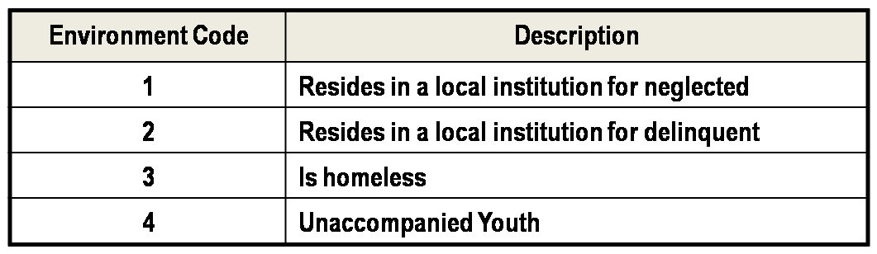
Prevention & Intervention Strategies
  ENVIRONMENT CODE indicates the type of residential environment in which a student resides or the type of school the student attended at anytime during this school year at this school. Code only those students for whom one of the codes below apply. For students where codes do not apply, leave blank.

Slide 38
Prevention & Intervention Strategies
Take a few minutes to discuss the following with your colleagues:
Does your LEA have a way to disaggregate data by the environment code?
Do you know the person in your LEA who may need data for N&D students?
Do you know the person in your LEA who may need data for homeless students?

Slide 39
Prevention & Intervention Strategies
Consider these facts about homeless children in the United States:
In one year, 42% transferred schools at least once. Of these, 51% transferred twice or more.
28% will attend three or more different schools in one year.
With each change in schools, it is estimated that a student is set back academically by an average of four to six months.
Many lack basic school supplies and a reasonable environment in which to do homework.
Three quarters of older homeless students drop out of school.

Slide 40
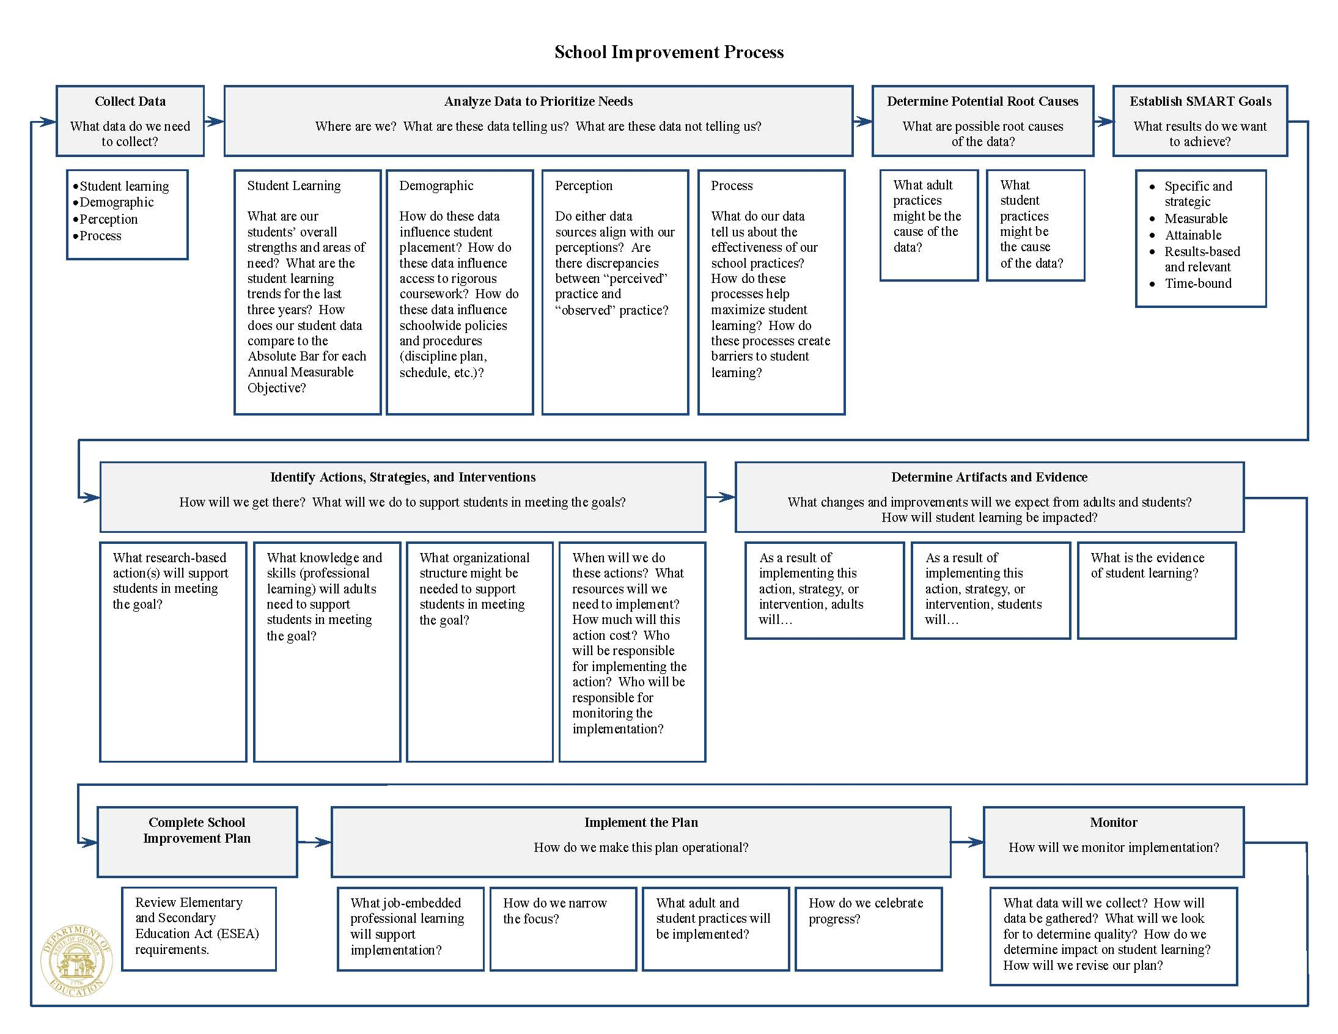

Slide 41
Prevention & Intervention Strategies
Support at-risk students:
  Model positive and respectful behavior.
  Offer guidance, stability, and assistance in making intelligent, personal, and educational choices.
  Garner family and community support.
  Triage efforts of school leadership, teachers, and other student support staff to acquire resources, broker extra help, and address individual and collective challenges.
Bridgeland, Dilulio, & Morison, 2006; Goldschmidt & Wang, 1999; Hammond, Linton, Smink, & Drew, 2007; Howard & Johnson, 2002; Ingels et al., 2002; Tinto, 1987; Roderick, 1993; Wehlage, 1989; Wehlage et al., 1989
Notes:
Research suggests that students who develop ongoing relationships with caring adults in an educational setting feel a greater sense of school membership, engagement, and involvement (Bridgeland, Dilulio, & Morison, 2006; Goldschmidt & Wang, 1999; Hammond, Linton, Smink, & Drew, 2007; Howard & Johnson, 2002; Ingels et al., 2002; Tinto, 1987; Roderick, 1993; Wehlage, 1989; Wehlage et al., 1989). Positive adult-student relationships have been associated with improved student achievement, communication, and social skills and decreased instances of student misconduct, absenteeism, and school dropout (Grossman & Garry, 1997; McPartland & Nettles, 1991; Nisbett, 2009; Pringle, Anderson, Rubenstein, & Russo, 1993; Sipe, 1996; Smith, Oaks, & Rosenberg, 1991).
Provide At-Risk Students with Wrap-Around Support
Develop a Graduation Team(s) that includes administrators, teachers, advisors, counselors, social workers, and/or other relevant service providers to help identify at-risk students, assess school/student needs, develop/coordinate appropriate interventions and generate individualized support.
Graduation Team(s) may utilize existing school teams, such as School Leadership, Improvement, and/or Student Support.

Slide 42
Prevention & Intervention Strategies
Implement schoolwide support
and interventions:
  Develop and implement credit recovery and alternative options, adapt curriculum, and differentiate instruction to meet the needs of identified at-risk students.
  Provide training and/or support
  to teachers on strategies that work
  with at-risk youth.
Alexander, Entwisle, & Kabbani, 2001; Battin-Pearson et al., 2000; Bridgeland, Dilulio, & Morrison, 2006; Ekstrom, Goertz, Pollack, and Rock, 1986; Jordan, Lara, & McPartland, 1994; Wagner et al., 1993
Notes:
Implement of Early Intervention and Remediation Programs for Academically At-risk Students. Because an individual’s academic performance has been found to significantly impact his chances for high school completion (Alexander, Entwisle, & Kabbani, 2001; Battin-Pearson et al., 2000; Bridgeland, Dilulio, & Morison, 2006; Ekstrom, Goertz, Pollack, & Rock, 1986; Ensminger & Slusarcick, 1992; Jordan, Lara, & McPartland, 1994; Rumberger, 2001; Wagner et al., 1993), academic intervention and remediation programs designed to assist students in recovering credit, improving academic performance, and re-engaging at-risk children in school are a critical part of the dropout prevention process.
Arrange opportunities for academically at-risk students to engage in credit recovery courses, general academic tutoring, and preparatory/remediation support sessions for both individual subject courses and state-level content area assessments. Designed to offer personalized attention and specialized instructional support at each student’s emergent learning level, these extra help opportunities, which can take place in one-on-one or small group settings during the school day, after school, on the weekend, or as part of a summer enrichment program, provide a safe environment for struggling students to learn, receive assistance and encouragement, and develop the self-confidence they need to persist in challenging courses. Most significant, however, is the power of such support structures to offset cycles of academic frustration and enrich scholarly experiences for students who have often become discouraged about learning and dissatisfied with school (Belfantz & Letgers, 2004).

Slide 43
Prevention & Intervention Strategies
Provide Direct Service and Case Management:
  Develop and implement individual, small group, and whole school intervention and prevention strategies to help students stay in school and graduate.
  Create a graduation and career plan that can track progress and follow students from grade to grade
  to ensure consistent support.
  Offer personal, academic, and career advisement.
Berk, 2000; Bronfenbrenner, 1979; Myers, Varkey, & Aguirre, 2002; Schaffer, 2006
Notes:
Frequently, students who exhibit risk factors for high school noncompletion require the consistent personal attention, encouragement, and support of adult role models in order to achieve and maintain success in school and life (Bridgeland, Dilulio, & Morison, 2006; Bronfenbrenner, 1979; Bronfenbrenner, 1990; Goldschmidt & Wang, 1999; Grossman & Garry, 1997; Hammond, Linton, Smink, & Drew, 2007; Ingels et al., 2002; McPartland & Nettles, 1991; Pringle, Anderson, Rubenstein, & Russo, 1993; Sipe, 1996; Smith, Oaks, & Rosenberg, 1991; Wehlage, 1989; Wehlage et al., 1989).
Advise students on issues of personal development, social support, and post secondary preparation, offering services related to behavior and discipline management, life skills training, leadership and character development, service learning, skill development, job shadowing, and career planning. Assist students in undertaking career, personality, and interest exploration inventories in an effort to investigate and plan their options for the future. Provide academic advisement services, addressing issues of chronic truancy, intellectual disengagement, and lackluster academic performance. Work to proactively combat issues related to scheduling, discipline, and classroom support by networking teachers, communicating with parents or guardians, and providing one-on-one and peer academic mentoring sessions in an effort to tender targeted support and foster in at-risk students a sense of belonging that many do not regularly experience in school.

Slide 44

Prevention & Intervention Strategies
Develop and maintain transition programs and vertical teams.
Assist in mediating conflicts, bridging communication gaps, brokering services, and negotiating bureaucracies among home, school, and community agencies.
Bridgeland, Dililio, & Morrison, 2006; Elliot & Voss, 1974; Hammond, Linton, Smink, & Drew, 2007; Ingels et al., 2002; Roderick, 1993
Notes:
Many students experience challenges accommodating to changes in their personal, social, or academic structures (Gleason & Dynarski, 2002; Rumberger, 2001; Teachman, Paasch, & Carver, 1996). To combat these challenges, schools should work to develop and maintain functional transition and parental involvement programs designed to ease the conversion of students from elementary to middle school, middle to high school, and high school to college and/or the workforce.
Collaborate with feeder school(s) to prepare students for building and grade level transitions.
Identify incoming students needing proactive support.
Participate on vertical teams with other coaches, faculty, and staff from feeder/cluster schools to develop transition plans.
Collaborate with teachers, counselors, and advisors to implement transition processes for rising/incoming students.
Particularly in times of change, positive interpersonal interaction with caring adults can assist a child in relating and adjusting to personal and academic challenges, the skills and confidence encouraged by such interactions serving to increase the child’s facility to effectively explore and grow from his experiences (APA, 2009; Berk, 2000; Bronfenbrenner, 1979; Cairns, Cairns, & Neckerman, 1989). As student and family advocates, schools must assist in mediating conflicts, bridging communication gaps, brokering services, and negotiating bureaucracies among home, school, and community agencies. Link students and families to appropriate services targeted toward their individual needs. Drawing upon the resources of pre-established community service networks to arrange for required services that fall beyond the scope of the school, pre-referral counseling and family outreach activities can help students and their families feel welcome within the school setting and educated regarding the assistive services options that the school stands ready to broker or provide.
Provide support and outreach to parents/guardians of students identified as being at risk of not graduating.
Connect students and parents with community-based programs such as Communities In Schools, Family Connections, after school programs, Georgia College 411, technical colleges, etc.
Develop or work with local mentoring programs, businesses, and/or community coaches to connect students with mentors.

Slide 45
Prevention & Intervention Strategies
Combat family, school, and community culture issues that may hinder a student’s chances of achieving educational success.
Develop cultures that value learning, hold high expectations for the scholastic outcomes of all students, and celebrate academic achievement.
Notes:
Because substandard academic performance and attendance rates are primary predictors for high school noncompletion (Alexander, Entwisle, & Kabbani, 2001; Battin-Pearson et al., 2000; Ensminger & Slusarcick, 1992; Goldschmidt & Wang, 1999; Rumberger, 2001; Wagner et al., 1993), schools must work to assist their staffs and local communities in the development of cultures that value learning, hold high expectations for the scholastic outcomes of all students, and celebrate academic achievement. In many cases, this involves working with educational stakeholders to investigate their personal and collective beliefs about student learning, educating members of the local community on the potential individual and social impact of high school dropout, addressing with teachers the detrimental effects of questionable grading practices and low-level expectations for the quality of student work, and engaging their school leadership teams to inform decisions concerning equity and access to resources, support, and rigorous academic standards for all students (APA, 2009; GaDOE, 2009a; Hammond, Linton, Smink, & Drew, 2007).

Slide 46
Prevention & Intervention Strategies
Georgia House Bill 400 – Bridges Legislation
Legislation focuses on students receiving quality career advisement and links the high school course work with their future college and career goals.
The implementation of the BRIDGE (Building Resourceful Individuals to Develop Georgia’s Economy) Act will become an integral part of a student’s educational plan this year.
The BRIDGE Act will help students and parents work together to enhance their child’s education to reach their goals and dream career.
The most critical part of this recently signed law is the requirement for all students in middle and high school to receive annual career guidance and advisement to choose a career area, create an Individual Graduation Plan and graduate high school prepared to go to college or enter the work force.

Slide 47
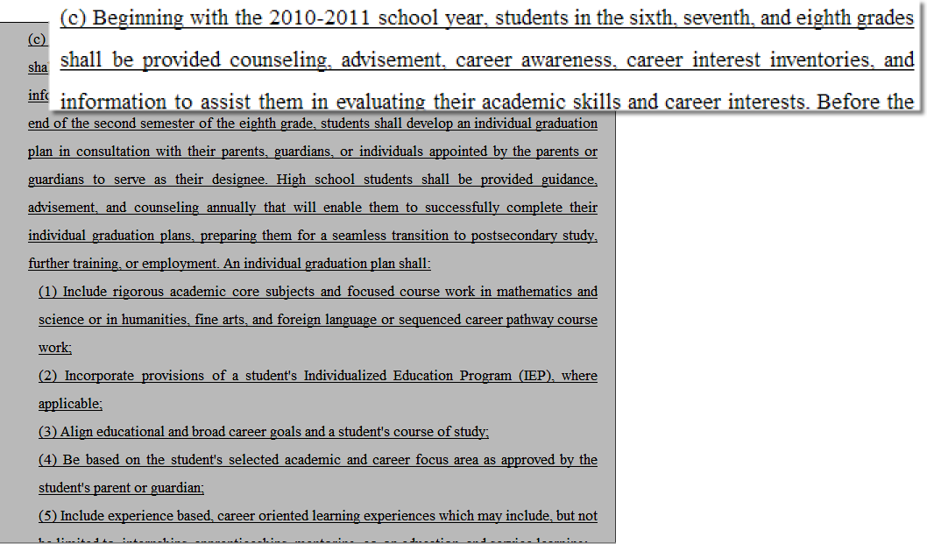
House Bill 400

Slide 48
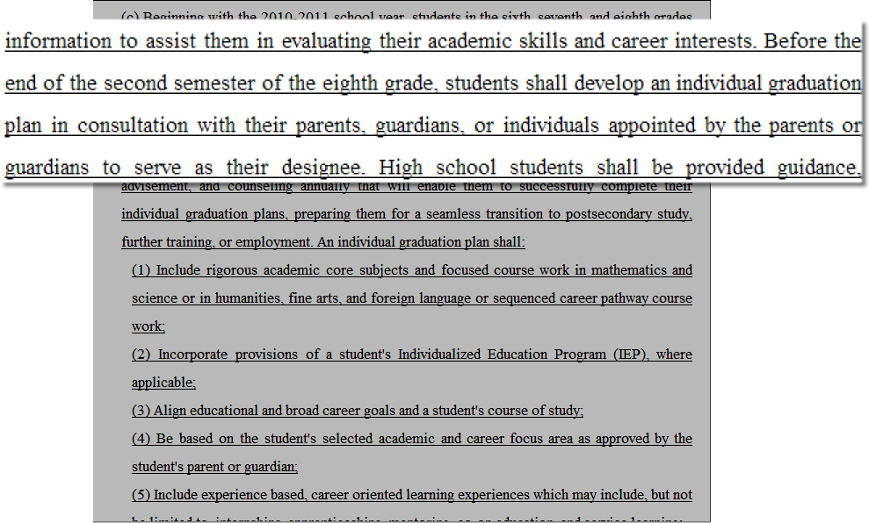

Slide 49
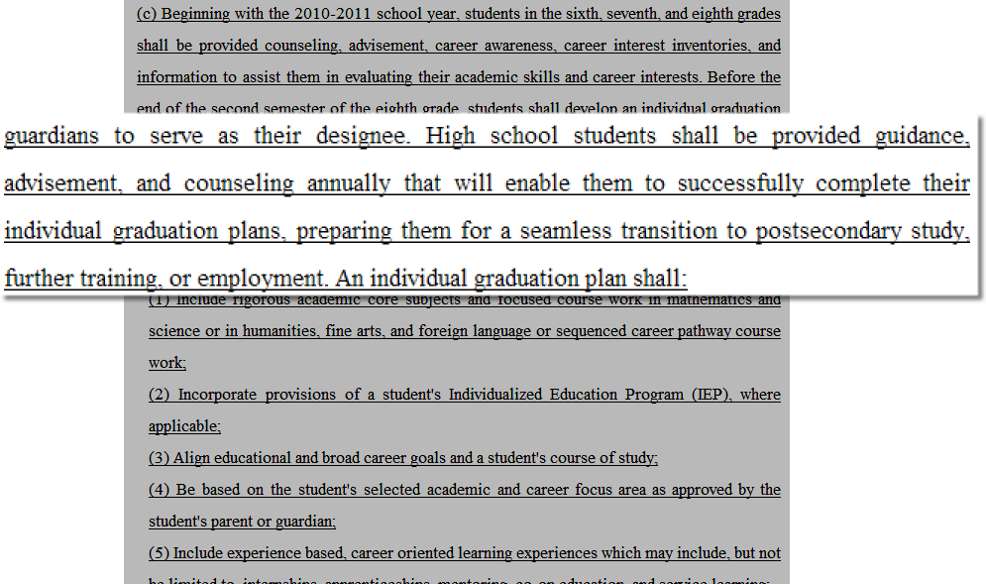

Slide 50
Prevention & Intervention Strategies
The Individual Graduation Plan
Include rigorous academic core subjects and focused course work in mathematics and science or in humanities, fine arts, and foreign language or sequenced career pathway course work;
Incorporate provisions of a student's Individualized Education Program (IEP), where applicable;
Align educational and broad career goals and a student's course of study;
Be based on the student's selected academic and career focus area as approved by the student's parent or guardian;
Include experience based, career oriented learning experiences which may include, but not be limited to, internships, apprenticeships, mentoring, co-op education, and service learning;
Notes:
MAKE HANDOUT
This slide represents the individual parts of the graduation plan. We have underlined those parts so significant to CTAE. Read those parts that have been underlined In the last part “teacher adviser” is noted as one of the delivery methods for comprehensive advisement being facilitated through CTAE. GaDOE is supporting and encouraging systems to consider a combined TAA and counseling program coupled with the utilization of GAcollege411 to meet the demands of the BRIDGE Bill. There are TAA resources available on GeorgiaStandards.org and GAcollege411 for systems that may choose this method of delivery. CLICK

Slide 51
Prevention & Intervention Strategies
The Individual Graduation Plan
Include opportunities for postsecondary studies through articulation, dual enrollment, and joint enrollment;
Be flexible to allow change in the course of study, but be sufficiently structured to meet graduation requirements and qualify the student for admission to postsecondary education; and
Be approved by the student and the student's parent or guardian with guidance from the student's school counselor or teacher adviser.
An individual graduation plan shall be reviewed annually, and revised, if appropriate, upon approval by the student and the student's parent or guardian with guidance from the student's school counselor or teacher adviser. An individual graduation plan may be changed at any time throughout a student's high school career upon approval.
Notes:
MAKE HANDOUT
This slide represents the individual parts of the graduation plan. We have underlined those parts so significant to CTAE. Read those parts that have been underlined In the last part “teacher adviser” is noted as one of the delivery methods for comprehensive advisement being facilitated through CTAE. GaDOE is supporting and encouraging systems to consider a combined TAA and counseling program coupled with the utilization of GAcollege411 to meet the demands of the BRIDGE Bill. There are TAA resources available on GeorgiaStandards.org and GAcollege411 for systems that may choose this method of delivery. CLICK

Slide 52
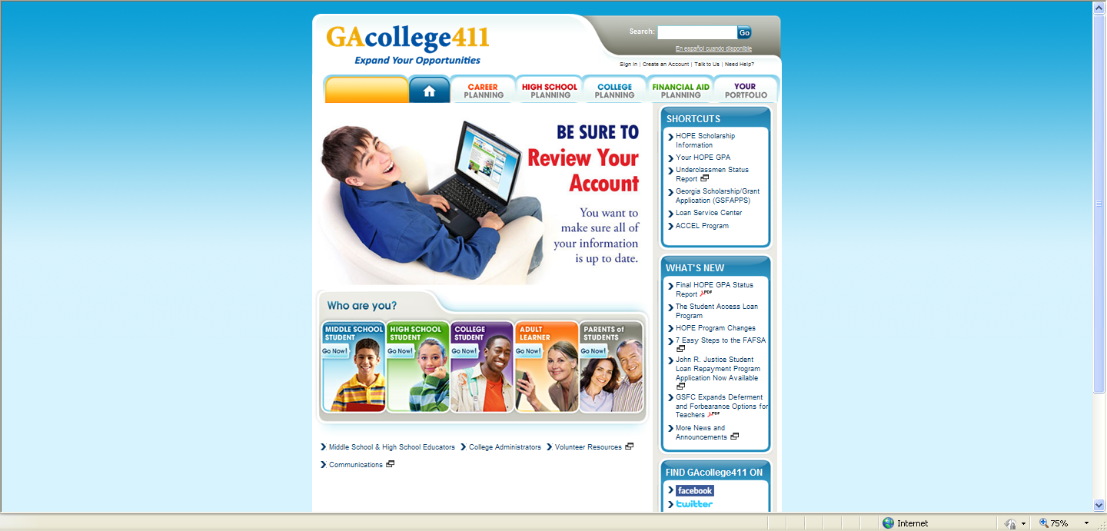
Prevention & Intervention Strategies www.gacollege411.org

Slide 53
Prevention & Intervention Strategies
School Factors: We largely have direct control over these!

Slide 54
Prevention & Intervention Strategies
School Risk Factors:
Low academic skills and achievement, especially reading.
Retentions (retained one or more times during school career).
Course failures.
Behavioral/disciplinary problems.
Poor attendance (15+ absences- current or previous year).
Transience.
Large classes/large schools.
Lack of guidance/advisement.
Inappropriate/ineffective instruction.
School located in high violence/crime community.

Slide 55
Prevention & Intervention Strategies
School Protective Factors:
Supportive, nurturing, and caring environment.
Viable, rigorous curriculum - Guaranteed for ALL.
Adequate fiscal and human resources.
Culture of high student and staff expectations exists.
Smaller class sizes.
Social, health, and mental health support services available.
Provides consistent, fair rules for student behavior.
Promotes tolerance and diversity.
Safe and orderly environment; routines are established.
Can we enhance any of the above positive school factors?

Slide 56
Prevention & Intervention Strategies
Take a few minutes to discuss the following with your colleagues:
Does your LEA currently collect data that could assist with the strategies presented in the slides above?
Do you know the person in your LEA who uses data to generate:
  School plans
  Individual graduation plans?
How do your responsibilities apply to addressing the needs of academically vulnerable students.

Slide 57
Contact Information
Eric McGhee
Grant Programs Manager
School Improvement
Twin Towers East, Suite 1866
205 Jesse Hill Jr. Drive SE
Atlanta, GA 30334
(404) 651-7555 - Office
(404) 657-1534 - Fax
emcghee@doe.k12.ga.us

